Slide 1
LECTURE-9 SOFTWARE PROJECT PLANNING: COST ESTIMATION
Software Project Planning :
A software project is the complete methodology of programming advancement from requirement gathering to testing and support, completed by the execution procedures, in a specified period to achieve intended software product.
Need of Software Project Management :
Software development is a sort of all new streams in world business, and there's next to no involvement in structure programming items. most programming items are customized to accommodate customer's necessities.
The most significant is that the underlying technology changes and advances so generally and rapidly that experience of one element may not be connected to the other one. all such business and ecological imperatives bring risk in software development; Hence, it is fundamental to manage software projects efficiently.

Slide 2
Software Project Manager :
Software manager is responsible for planning and scheduling project development. they manage the work to ensure that it is completed to the required standard.
They monitor the progress to check that the event is on time and within budget. the project planning must incorporate the major issues like size & cost estimation scheduling, project monitoring, personnel selection evaluation & risk management.
To plan a successful software project, we must understand:
Scope of work to be completed
Risk analysis
The resources mandatory
The project to be accomplished
Record of being followed

Slide 3
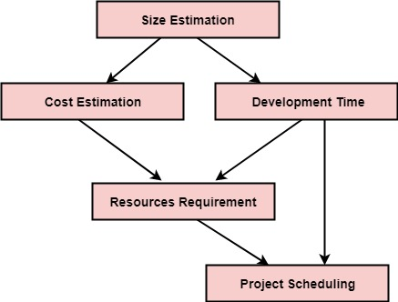
Software Project planning starts before technical work start. The various steps of planning activities are:
The size is the crucial parameter for the estimation of other activities. resources requirement are required based on cost and development time. Project schedule may prove to be very useful for controlling and monitoring the progress of the project. This is dependent on resources & development time.

Slide 4
Software Cost Estimation:
For any new software project, it is necessary to know how much it will cost to develop and how much development time will it take. These estimates are needed before development is initiated, but how is this done?
Several estimation procedures have been developed and are having the following attributes in common.
Project scope must be established in advanced.
Software metrics are used as a support from which evaluation is made.
The project is broken into small PCs which are estimated individually. To achieve true cost & schedule estimate, several option arise.
Delay estimation
Used symbol decomposition techniques to generate project cost and schedule estimates.
Acquire one or more automated estimation tools.

Slide 5
Uses of Cost Estimation :
During the planning stage, one needs to choose how many engineers are required for the project and to develop a schedule.
In monitoring the project's progress, one needs to access whether the project is progressing according to the procedure and takes corrective action, if necessary.

Slide 6
QUESTIONS:
1. Which of the following is an important factor that can affect the accuracy and efficacy of estimates?
a) PROJECT SIZE
b) Planning process
c) Project complexity
d) Degree of structural uncertainty
2. What describes the data and control to be processed?
a) Planning process
b) SOFTWARE SCOPE
c) External hardware
d) Project complexity
3. Which of the following is not an option to achieve reliable cost and effort estimate?
a) Base estimates on similar projects that have already been completed
b) Use one or more empirical models for software cost and effort estimation
c) Use relatively simple decomposition techniques to generate project cost and effort estimates
d) THE ability to translate the size estimate into human effort, calendar time, and dollars

Slide 7
QUESTIONS:
4. Software project estimation can never be an exact science, but a combination of good historical data and systematic techniques can improve estimation accuracy.
a) TRUE
b) False
5. Which of the following is not achieved by an automated estimation tools?
a) Predicting staffing levels
b) Predicting software cost
c) Predicting software schedules
d) Predicting clients demands

